Slide 1

QUANTUM SIMULATOR
-Shivalee RK Shah

Slide 2

HELLO!
I am Shivalee RK Shah
This a presentation for my QWorld project Quantum Simulator which was made from scratch without using any libraries like qiskit or numpy

Slide 3
Table of Contents
Introduction
Why Quantum SImulator
Working of my Quantum Simulator
Comparing it with IBM Simulator
Learning and Outcomes
References

Slide 4
1.
INTRODUCTION

Slide 5
A loosely stated definition of simulation is the use of one physical device to tell us about another real physical system
Notes:
We pick an idealised model describing a system of interest, and then simulate that model, taking the output to describe not only the model but the system of interest.
For eg a computer is nothing but an accurate simulator
Quantum simulators permit the study of quantum system in a programmable fashion.

Slide 6
2. WHY QUANTUM SIMULATOR?

Slide 7
Quantum model on classical is inefficient
Quantum devices will one day be able to solve larger problems than their classical counterparts.
Notes:
Calculating properties of an arbitrary quantum model on a classical device is a seemingly very inefficient thing to do (taking a time that scales exponentially with the number of particles in the model being simulated), but a quantum device might be able to do this efficiently
the size of problems that can be tackled in a reasonable time grows significantly more quickly with the size of the simulating device than it does for a classical device, thus it is envisaged that quantum devices will one day be able to solve larger problems than their classical counterparts.

Slide 8
3.
WORKING OF MY QUANTUM SIMULATOR

Slide 9
Class QuantumProgram:
Methods to perform :
mathematical computations
single qubit gate operations
two qubit gate operations
three qubit gate operations
and
Methods to simulate the quantum circuit

Slide 10
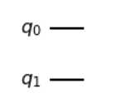
__init__ method
Initial state_vector considering all qubits in |0> state
Number of qubits
I
I
Initial unitary matrix considering identity on each qubit
Basis state list according to number of qubits

Slide 11
basis_state: decimal to binary string
Parametre:
Decimal number to be converted
Number of qubits
Returns: binary number in string form
Eg:
basis_state(3) for 2 qubits:
‘11’

Slide 12
create_matrix
Parametre:
Number of rows/columns to needed in matrix
Returns: a matrix in list form with all elements initialised to 0
Eg:
create_matrix(2):
[[0,0]
[0,0]]

Slide 13
binary_to_decimal
Parametre:
Binary number to be converted ..should be inputted in int form
Returns: Decimal number
Eg:
binary_to_decimal(101):
5

Slide 14
vector_mat_mul
Parametre:
vector
matrix
Returns: multiplies matrix and vector
and prints the result as vector

Slide 15
mat_mat_mul
Parametre:
First matrix to multiplied
Second matrix to be multiplied
Returns: A matrix that is product of the input matrices

Slide 16
Tensor_vector
Parametre:
Vector 1
Vector 2
Returns: tensored product of the input vectors

Slide 17
Tensor_matrix
Parametre:
First matrix
Second matric to be tensored
Returns: A matrix that is tensored product of above matrices

Slide 18
SINGLE-QUBIT
H-gate, X-gate, Z-gate, Rotation gate

Slide 19
H-gate(qubit_index)
Unitary matrix
Start with 1
Multiply the tensored matrix to unitary matrix to get a new one
If index does not match tensor Identity matrix
If index matches then tensor hadamard operator

Slide 20
X-gate(qubit_index)
Unitary matrix
Start with 1
Multiply the tensored matrix to unitary matrix to get a new one
If index does not match tensor Identity matrix
If index matches then tensor not operator

Slide 21
Z-gate(qubit_index)
Unitary matrix
Start with 1
Multiply the tensored matrix to unitary matrix to get a new one
If index does not match tensor Identity matrix
If index matches then tensor Z operator

Slide 22
Rotation-gate( angle, qubit_index )
Unitary matrix
Start with 1
Multiply the tensored matrix to unitary matrix to get a new one
If index does not match tensor Identity matrix
If index matches then tensor rotation operator
Ps. the angle should be in radians

Slide 23
TWO-QUBIT
CX-Gate, CZ-Gate, CR-Gate

Slide 24
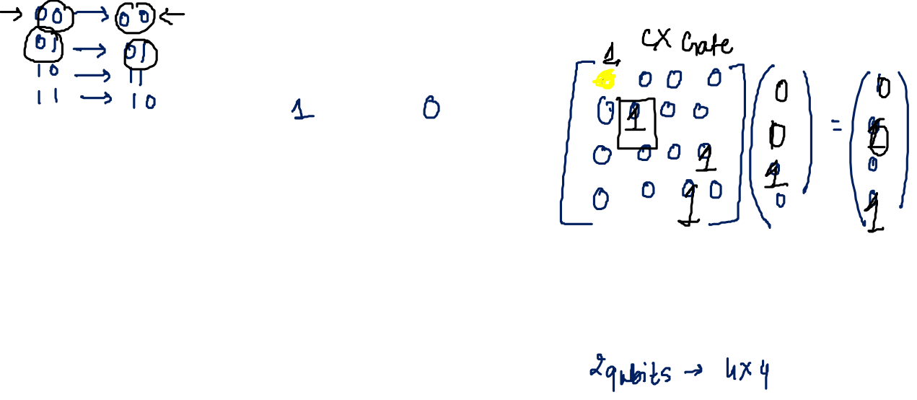
CX-Gate(control, target)
Unitary matrix
Create a matrix with method creat_matrix with 2^n rows where n is number of qubits
Multiply the matrix to unitary and get new unitary
Tweak the matrix according to control and target indices

Slide 25
CZ-Gate(control, target)
Unitary matrix
Apply H gate to target
Apply H gate again to target
Apply CX gate to control, target

Slide 26
THREE-QUBIT
CCX-Gate

Slide 27
CCX-Gate(control1, control2, target)
Unitary matrix
Create a matrix with method creat_matrix with 2^n rows where n is number of qubits
Multiply the matrix to unitary and get new unitary
Tweak the matrix according to control1, control2 and target indices

Slide 28
CIRCUIT SIMULATION
Read_state, read unitary, observing probabilities, execute

Slide 29
Read state
Returns state-vector which we get by multiplying the initial state with the unitary matrix

Slide 30
Read unitary
Return a single unitary matrix (quantum operator) equivalent to all defined quantum operators until this point, i.e., the multiplication of all quantum operators in the defined order.

Slide 31
Observing probabilities
Return the probabilities of observing the basis states if all qubits are measured at this moment.

Slide 32
Execute(the_number_of_shots):
Parametre : number of shots
Return the observed outcomes with their frequencies.

Slide 33
4.
Comparing it with IBM simulator

Slide 34
5.
Learning and outcomes

Slide 35
OUTCOMES
While working for 2 qubit gates it gave me a better understanding on how the matrixes which we have for different gates are formed
Dec 8: submitted the project proposal
Developed code for single qubit gates
1
3
5
2
4
6
Midterm report submission
Started understanding why quantum simulators and dwelled deeper in abstraction layers
Final report submission

Slide 36
6. References
http://www3.physics.ox.ac.uk/groups/qubit/fetch.asp?url=groupwebsite/papers/paper311.pdf
https://en.wikipedia.org/wiki/Quantum_simulator
QWorld Bronze notebooks

Slide 37
THANK YOU!
You can find me at:
shivaleerks12@gmail.com
Gitlab repo link: https://gitlab.com/shivaleerks12/qworld-project

